Slide 1


Aurora
Robotics
Robotics in AI
An Introduction to Machine Learning
combining the mechanical precision of robots with the cognitive power of AI, we are witnessing machines that can perceive, learn, decide and act autonomously. Unlike traditional programmed robots that follow fixed instructions, AI-powered robots can adapt to new situations, analyze data in real-time and make intelligent decisions
Fields of AI in Robotics
1. Machine Learning (ML) enables robots to learn from data and experiences rather than relying solely on hard-coded instructions. It allows robots to identify patterns, make predictions and continuously refine their behavior.
2. Computer Vision gives robots the ability to see, interpret and understand their environment using cameras and sensors. It serves as a robot’s “eyes,” enabling perception and spatial awareness.
3. Natural Language Processing (NLP) allows robots to understand, interpret and generate human language, making human-robot interaction natural and intuitive. It bridges the communication gap between humans and machines.
Run into
The UNKNOWN
Forza
Aurora

Slide 2
Aurora
Robotics
Robotics in AI
An Introduction to Machine Learning
4. Simultaneous Localization and Mapping (SLAM) enables robots to build a map of an unfamiliar environment while keeping track of their position within it — a crucial function for autonomous movement and exploration.
5. Expert Systems and Knowledge Representation simulate human reasoning using structured knowledge and logical rules, enabling robots to solve problems intelligently. Knowledge representation organizes information so robots can reason, plan and make decisions.
6. Deep Learning and Neural Networks use multi-layered neural networks to mimic human brain functionality, allowing robots to process complex data such as images, audio and motion patterns with exceptional accuracy.
Run into
The UNKNOWN
Forza
Aurora

Slide 3
Aurora
Robotics
How Robots sense the world
Visual Cameras
Much like people, robots’ ability to explore their surroundings frequently relies on visual data. Cameras allow robots to see the world around them and allow operators to easily interpret what the robots are seeing
Lidar and Laser Scanning
Lidar (Light Detection and Ranging) is a form of sensing which uses lasers to detect features of the environment, emitting pulses of near infrared light and measuring the returning pulse. Using this data is used to generate 3D maps, providing an in-depth awareness of the robots surroundings.
Exteroceptive sensors
serve as a robot's windows to the outside world, mimicking human senses to gather data about the surrounding environment. By capturing critical external stimuli such as light via cameras, and physical pressure via tactile skin
Run into
The UNKNOWN
Forza
Aurora

Slide 4
Aurora
Robotics
Domains, Goals, Actions: Planning 101
An Introduction to PDDL
Planning involves converting high-level objectives for a robot or robot team into specific sequences of actions that can be executed using lower level control algorithms tailored to the individual robots.
We can describe a system using a specification languages
The Planning Domain Definition Language (PDDL) is a simple and standard way to describe planning problems for computers.
It helps define all the things, actions and goals needed for a computer to plan out a series of actions to solve a problem like moving robots
Run into
The UNKNOWN
Forza
Aurora

Slide 5
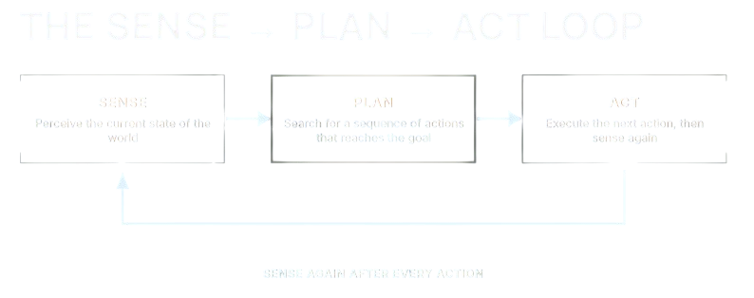
Aurora
Robotics
Sense Plan and Act Loop
PDDL lives entirely inside the Plan step. It is how the robot reasons about which actions to take.
Sensing turns camera and sensor data into facts. PDDL consumes those facts; it does not produce them.
Acting drives motors and grippers. The plan says which action; the controller performs it.
Run into
The UNKNOWN
Forza
Aurora

Slide 6
Aurora
Robotics
Two ways to program a robot's behavior robot’s behavior
Hard-code every scenario
Describe the rules
Write an if/else branch for each situation you can imagine. The engineer decides what the robot does in every case, in advance
The robot executes. It never reasons about a case you did not write.
Give the robot the world's logic: what is true, what actions exist, and what counts as done. A planner searches for the steps.
The robot reasons. New situations get a new plan, not new code.
Run into
The UNKNOWN
Forza
Aurora

Slide 7
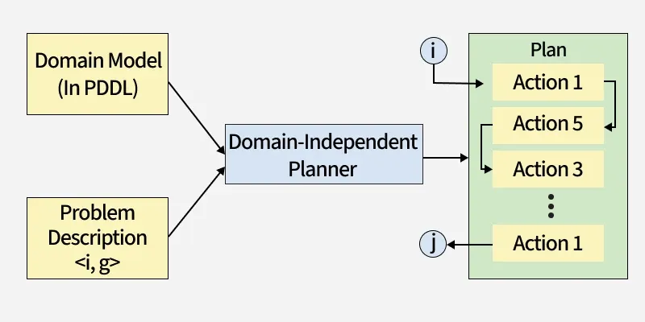
Aurora
Robotics
PDDL describes planning problems using plain text files written in a specific format. There are always two parts.
Domain File: Lists all the actions and types of items in the problem area.
Problem File: Lists the specific items such as the starting state and the goal to reach.
Run into
The UNKNOWN
Forza
Aurora

Slide 8
Aurora
Robotics
The PDDL Model
State
Predicate
Action
Domain
Problem
What is true at the moment(a collection of facts). This could be the initial, goal state
It describes relationships between objects or the status of an object
defines how the state of the world can be transformed
defines the general physics, rules, and capabilities of a world.
A specific instance or scenario belonging to a domain
PDDL assumes that if a fact is not explicitly stated as true, it is false. There is no "unknown": every predicate is either true or false, never undetermined.
The initial state must enumerate every fact the plan depends on. Silence means "no", so an omitted corridor is a wall.
The planner reasons quickly because it never chases unstated possibilities. A finite state, not an open world.
Run into
The UNKNOWN
Forza
Aurora

Slide 9
Aurora
Robotics
let’s take a practical look into PDDL with VsCode
Run into
The UNKNOWN
Forza
Aurora

Slide 10
Aurora
Robotics
RECAP & QUESTIONS
Run into
The UNKNOWN
Forza
Aurora

